Slide 1
Hybrid Accident Detection and Prevention System with Integrated Drowsiness Detection
By – Sayak Ray (21BCE0752)

Slide 2
Introduction
The scope of this project includes developing a prototype of an accident prevention system that can detect facial gestures and interpret them as indicators of fatigue or distraction. The system will be designed for real-time monitoring, enabling it to promptly alert drivers when necessary. It is aimed at private, commercial, and public transport vehicles, offering a scalable and cost-effective solution adaptable to different types of vehicles.
Objective of the project is to develop an affordable and efficient system that is successful in saving people from car accidents and injuries that can happen to them by making them alert whenever there is danger of collision or drowsiness.

Slide 3
Introduction
We will use Ultrasonic sensors for initial detection of object and size and distance measurement. Constant analysis of distance is done and based on this severity of object is noted. If severe then a buzzer makes a sound to alert the driver.
If not severe then a warning is displayed on the drivers display to alert them and the situation is constantly analyzed. If collision occurs then the speaker is used to make an alert noise to get help from nearby drivers. Constant face detection is done and if the driver is drowsy then they are alerted using the buzzer and speaker system. The entire system is implemented on Arduino and installed in cars for their security.

Slide 4
Introduction
To conclude, the significance of accident-avoidance systems is huge in our urban cities since they help in eliminating risks, saving lives in the process, and enhancing road transport safety and efficiency. They are important in addressing complications brought about by human beings, improving the attention of the driver as well as addressing the creation of advanced automated and ecological transport systems. In essence, with the introduction of these systems in cars, smart cities and transport networks, we are all set on safer, more accident free roads and better transport systems.

Slide 5
Gaps Identified
The gaps have been identified above for each paper. Most of the systems have provided some solution to the issue but each have some drawbacks. The gaps that can be identified are that most papers only try to prevent the collision for the primary car. If they had a communication system with nearby cars then the system could warn nearby cars that a collision can occur so they can slow down and be cautious. Other gaps are that some papers only detect the collision and do not provide a system to prevent it. Lastly some papers have the gaps that they implement the safety measures after the collision has happened and do nothing to prevent it.

Slide 6
Methodology/Algorithm
Arduino Algorithm:
i. Detect if object is ahead
ii. If object is detected ahead. Analyze the severity by detecting distance size of object
iii. If severe:
a. Use the system buzzer to inform the driver at a high frequency and tone. Closer the object higher the frequency and tone of buzzer.
b. LCD of the car now displays a warning message.
c. Decelerate the motors at the rate of approaching object. Closer the object faster the deceleration

Slide 7
Methodology/Algorithm
iv. If not severe:
a. Display warning to inform driver.
b. Play the buzzer at a low frequency and tone
c. Slow the motors a bit.
d. Keep monitoring and warning till object is not ahead.
v. If collision occurs:
a. Use the buzzer to make the sound to alert others
vi. If clear and no object detected.
a. Keep monitoring the face of the driver for drowsiness
b. Alert the driver if drowsy

Slide 8
Methodology/Algorithm
Drowsiness Detection System Algorithm:
i. Use the camera to input image frames from video
ii. Convert to grayscale
iii. Place the Face Landmarks
iv. Use Euclid’s distance formula to calculate the distance between the length of the eyelid and two points of width of the eyelid
v. Calculate the ratio
vi. Depending on this ratio we evaluate whether the driver is sleeping, drowsy or Alert
vii. Calculate the distance between upper and lower lip
viii. If greater than threshold than the driver is yawning
ix. Alert the driver if he is sleeping, drowsy and/or yawning
x. Continue again from step 1

Slide 9
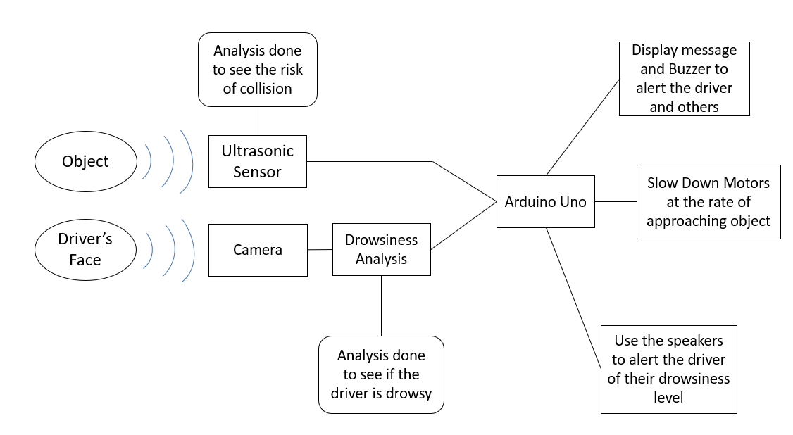
Block Diagram

Slide 10
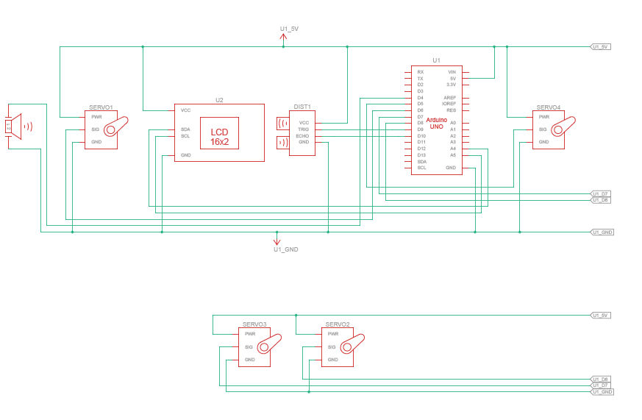
Arduino Schematic

Slide 11
Future Enhancements
The given system provides a very efficient system for accident prevention. In the future more features can be added for even more security like communication with emergency services if a collision occurs. More AI technologies can be used for better analysis of collision detection. There are newer algorithms that are still experimental but if successful in the future will definitely increase the efficiency of the system.
The existing mechanism can still be enhanced as it performs only in optimal conditions and its effectiveness reduces in adverse weather phenomena like fog, rain, or snow. In future studies, issues raised in this study may introduce different sensor types such as cameras or infrared ones in addition to the ultrasonic sensors. These sensors might prove to be more effective in such weather conditions, further enhancing the environments where the system would be effective and its overall strength. Furthermore, extending range and accuracy of the sensors may enable the system to identify such objects at considerable distances thus giving the drivers ample time to react especially under high speeds.

Slide 12
Conclusion
The Accident Prevention System employs ultrasonic sensors for obstruction counting, AI-based monitoring for drowsiness, as well as an alerting system is very effective in promoting road safety by dealing with both external and internal risk factors instantly. The ultrasonic sensors serve their purpose in detecting obstacles over short distances allowing for timely precautions from the drivers. This is despite the fact that sensors accuracy could be affected by external factors such as rain and fog. However, the main purpose of the system is executed quite well. In scenarios where very fast sensing speeds are required or the system has to operate in difficult weather, other sensors such as the infrared or radar can be used for better performance especially in complicated or high-risk areas.

Slide 13
Conclusion
The drowsiness detection system based on artificial intelligence was very effective in recognizing gestures caused by fatigue; this is very important for eliminating accidents caused by drivers’ lack of focus. The system helps in immediate intervention upon detection of drowsiness signs using facial recognition software and thus helps to prevent accidents associated with tiredness, and other factors leading to road traffic accidents. The speed and accuracy of the system indicate that integration was effective, however, issues with false identification of signs and differentiating them from normal facial expressions of slight distractions still exist. Adding other body functions such as heart rate monitoring can enhance the effectiveness of the system detection and on the overall rather than considering the state of the driver solely based on one indicator.

Slide 14
Conclusion
The system, which includes alert mechanisms, has completely changed the approach from passive monitoring to active intervention. Using auditory and visual alerts ensures that a driver is sufficiently warned and sensitized to the need for remedial actions, hence improving the safety potential of the system significantly. Testing showed that such alerts are acceptable and effective but less appealing due to the constant alert in most low-risk situations; alert frequency and sensitivity can be adjusted for better usability. The integration of various forms of alerts was especially helpful in ensuring the attention of the driver, thus making the system applicable to various driving conditions and environments.

Slide 15
Application towards design and development of Smart Cities
The Accident Prevention System (APS) with its ultrasonic sensors for obstruction detection, AI-based drowsiness detection, and a responsive alert system can be of great importance in smart city design and development. With technological advancements being introduced into city infrastructure, the focus shifts to enhanced road safety and optimized means of transport. Smart cities can incorporate traffic management systems within public and private vehicle fleets to minimize road accidents, enhance movement, and provide an urban mobility network that is safe and efficient. The system is a fundamental element in the construction of advanced and secure cities that will not only support the drivers but will also work with other smart city features in enhancing the safety of the public.

